Slide 1
Tesseract Health Services
Tesseract: Nihal Jahagirdar
Pranav Srikanth
Bhagat Singh S

Slide 2

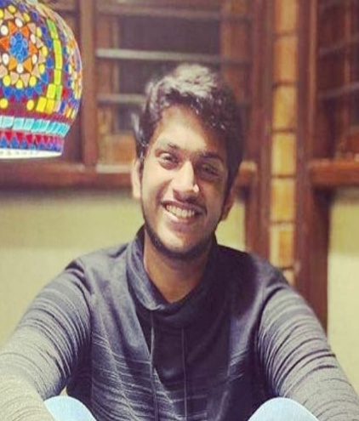
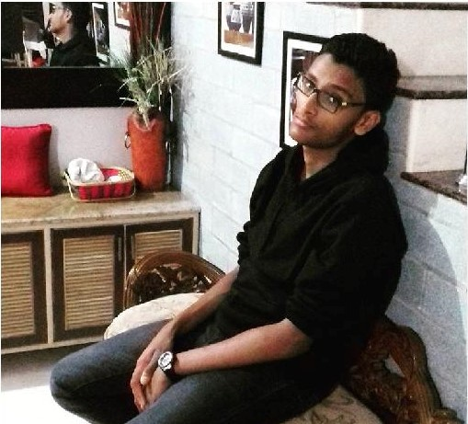
Nihal Jahagirdar : Eager to help society
Pranav Srikanth: Loves solving puzzles and anime WEEB
Bhagat Singh S: Strives for perfection

Slide 3
Our creation will address the following problems:
Substandard relations between Doctor and Patient.
Forging of patient data for felonious practices
Delayed consultation
Impotency to solve heterogenous health problems

Slide 4
Currently in India, it is very uncommon for doctors employed under different private hospitals to share reports or opinions, and in the event where you need a second opinion, you would have to go through the entire process of explaining the problems or the ailments one is good through, and through our idea we aim to create a pool of data where no matter which doctor you go to they will be able to access your past reports or records to give a more diagnosis for said patient.

Slide 5
“Time is money”, but that is not the case with hospitals, from travelling to hospitals to the filling of forms, a lot of time is lost. We aim to abate the loss of time through online consultation with certified doctors in close proximity.

Slide 6
Summary
To summarize, we are trying to help improve the patient-doctor relation and also prevent patient data from being stolen.
Let us talk about a real world example:
Suppose a patient visits a doctor for his diagnosis, but then decides to refer another doctor , he would have to go through the same process of diagnosis again subsequently paying more and leading to bad relation.
We aim to solve this problem by providing a secure database which can be accessed by doctors of the patient’s choice so that the patient would not need to spend more and can at the same time receive the best of treatments.
We also provide a service to order medicines and learning new reports.
The patient can interact with the doctor and can book appointments.
The patient is provided with a sleep timer and an exerciser tracker to help develop his/her overall well being.
The doctor can also view previous appointments attended by patient to oversee and

Slide 7
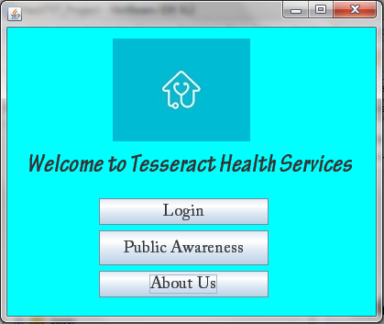
Screenshots

Slide 8
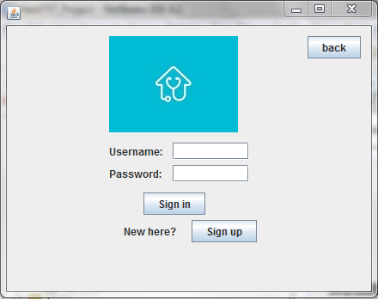
Login

Slide 9
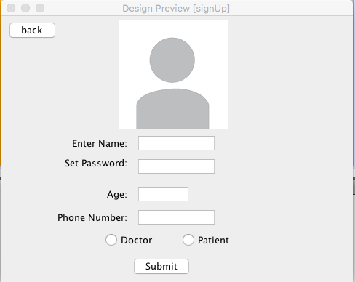
Sign Up

Slide 10
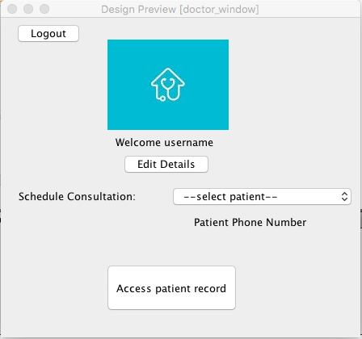
Doctor Window

Slide 11
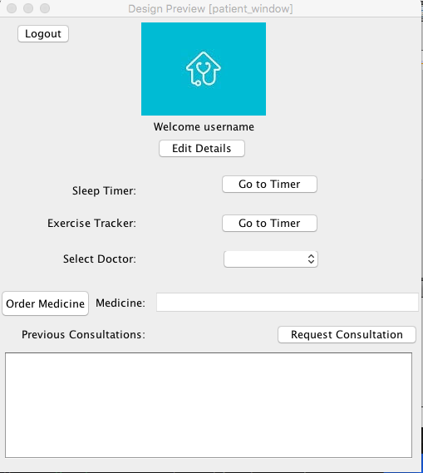
Patient Window

Slide 12
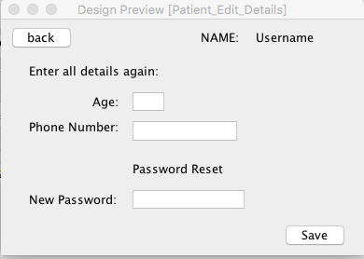
Edit Details

Slide 13
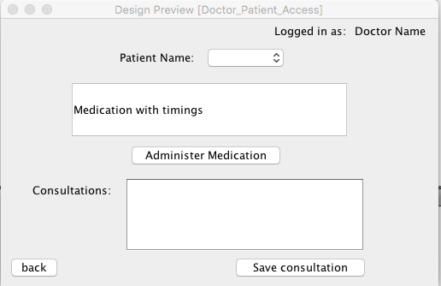
Doctor Patient Access Window

Slide 14
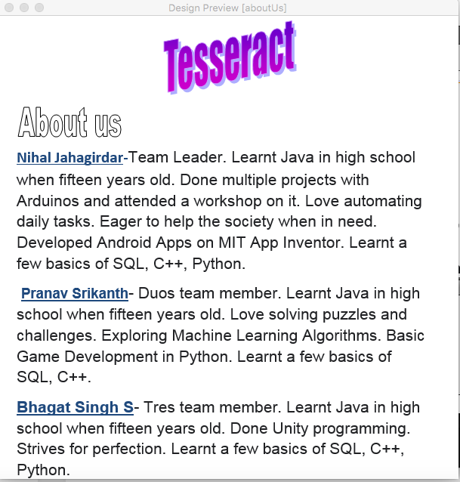
About Us Window

Slide 15
About The Program
Let us talk about a button called as “Access patient records”. This is arguably one of the most important functions(we do have many) in our program. The underlying problem in india is that, patients are not allowed to discuss their previous consultations by one doctor to another. This causes immense number of problems including a tremendous waste of time money as well as manpower, compared to when the problem could be solved if the doctors just have access to the previous records. Here our application comes to the rescue. We have developed the software in such a way that the consultations of the patient can be shared to any specialized doctor of their choosing, of course by their discretion. I believe this is something which should be scaled and immediately brought into action in a country like ours. Through this button the doctor can choose the desired patient using a combo button, and administer medicines as well as thoughtful instructions which can be accessed anytime by both the parties, leading to a better life style which every patient craves for. Not to worry, all the consultations are tamper free and can only be edited by doctors, but simply viewed by patients.

Slide 16
Contd…
What stands out in this section of the program is how the application is designed to care for the wellbeing of the patient. There are two sections which help track the sleep cycle as well as the exercise cycle of the patient. It will direct the user to a third party timer which is set for 8hr and 30 min respectively. It is highly recommended that the user use the features to its utmost potential. We soon notice another one of the Combination buttons which is in fact used to book an appointment for the preferred doctor. The patient gets to decide which doctor they would visit and using the request consultation button, would book an appointment to the said doctor. The doctor then decides a time to call back and confirm the booking, as we have already seen.
One other important feature is the Medicine ordering feature, where with just a click of a button, the user is directed to a trusted online pharmasi. The user is also given the opportunity to view their previous consultations and also the prescribed medicines by their doctor, but will be unable to edit in that space, as mentioned before.

Slide 17
Future Insights
We are eager to further develop this program as this is something crucial and very important for our country to possess
It helps not only patients who are in financially weak, but also doctors from spending too much manpower. It also enlightens the general crowd which is necessary for the growth of our country towards a healthier country.

Slide 18
A marketable opportunity
Definitely without doubt this can be used as a marketable source, but that is not how we see it. We want this service to reach every nook and Cranny and in general, bring up the welfare of the world as a whole!

Slide 19
Sources
We used an IDE called NetBeans to code most of the part of our software.
Stack overflow is another important source of knowledge
Of course EchoAR helped us in achieving that level of finesse we required to upgrade our code to a premium level.

